Slide 1


Day 3 - Modeling
Building Credit Scoring Model
pacmann.io
© 2022 – Pacmann AI

Slide 2
Outlines
Model
Evaluating Model
Cross Validation

Slide 3
Modeling Workflow (Simplified)
Data Preparation
Load data
Model Predictions
Create a predictions
Sample selection
Split data to Train, Valid, & Test
Create & Evaluate Model
Create a classification model
Tune the model
EDA
Perform data exploration
Data Preprocessing
Preprocess the data so that can be modeled
Missing value imputation
Remove outliers

Slide 4
Model
Notes:
Transisi antar outline

Slide 5
Model
Create a prediction from the input
Regression → what is the rating of an items? what is the price?
Classification → is this client default/not? is this a picture of lion/not?
Clustering → how to segment a customer?

Slide 6
Credit Scoring Model
We can see this as a classification model
“Is a borrower will be late in paying credit? Yes = 1, no = 0

Slide 7
Model to use
Parametric model
Logistic regression
Support vector machine
Non parametric model
K-NN
Decision Tree
Random forest
Boosting model

Slide 8
Model Output
Usually there are two prediction types:
Prediction of probability
Prediction of labels
if proba > threshold:
label = 1
else:
label = 0

Slide 9

What is it inside the model?
It’s calculus, probability, and linear algebra
image source

Slide 10
Evaluating the Model
Notes:
Transisi antar outline

Slide 11
Which model is better?
Actual Values | Model 1 Predictions | Model 2 Predictions
1 | 1 | 0
0 | 0 | 1
0 | 0 | 1
1 | 1 | 0
0 | 1 | 0

Slide 12
Which model is better?
Actual Values | Model 1 Predictions | Model 2 Predictions
1 | 1 | 0
0 | 0 | 1
0 | 0 | 1
1 | 1 | 0
0 | 1 | 0

Slide 13
How to measure that? Performance Metrics
Accuracy metrics
acc = # correct / # all data
acc_1 = 4/5 = 0.8
acc_2 = 1/5 = 0.2
Model 1 win!
Actual Values | Model 1 Predictions | Model 2 Predictions
1 | 1 | 0
0 | 0 | 1
0 | 0 | 1
1 | 1 | 0
0 | 1 | 0

Slide 14
Metric Performance for Classifications
Accuracy
Recall
Precision
F1 Score → For choosing the prediction threshold
AUC ROC → For choosing the best model
K-S
etc.

Slide 15
Cross Validation
Notes:
Transisi antar outline

Slide 16
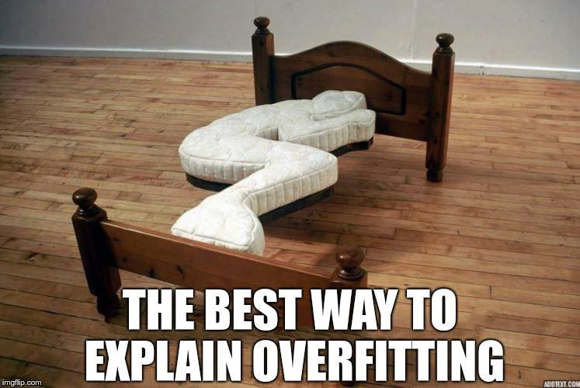
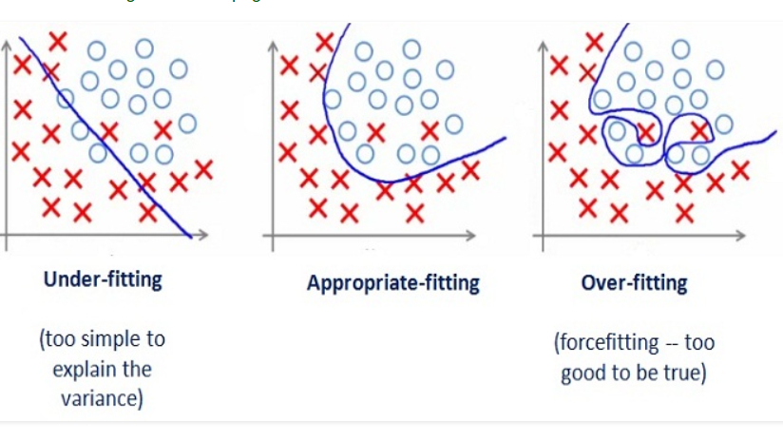
Find the best model
Objective : to prevent an overfit model
image source
image source

Slide 17
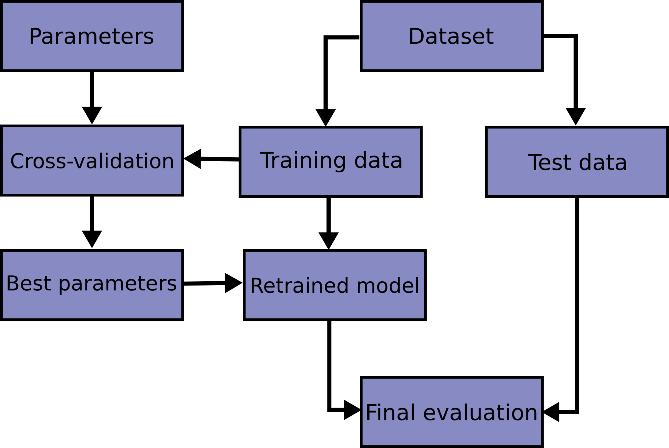
Finding the best model
From sklearn
Split train-valid-test data

Slide 18

Perform resample
Do the cross validation

Slide 19
Let’s Code!
Code references: https://github.com/amalinadhi/credit_analytics
Notes:
Transisi antar outline

Slide 20
Thank You
Notes:
Transisi antar outline

